Slide 1
The semantic web

Slide 2
Major Challenges of the WEb
?

Slide 3
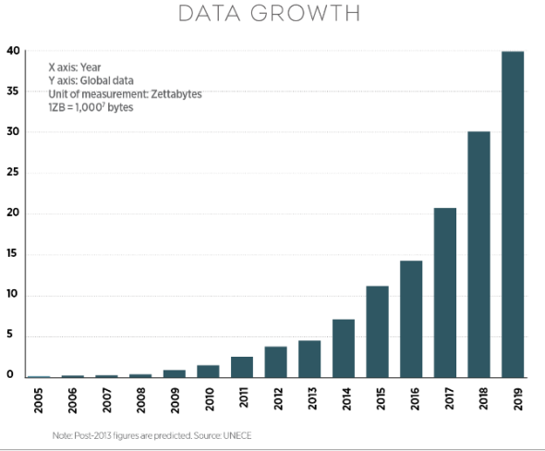
#1
http://www.nojitter.com/post/240170228/the-network-impact-of-big-data

Slide 4
Just a few facts…
More data has been created in the past 2 years than in the entire history of the human race
Every second we create new data. 40,000 searches on Google alone are made every second for a total of 1.2 trillion searches per year.
By 2020 1.7 megabytes of new information will be created every second for every human on the planet.
For a typical Fortune 1000 company just a 10% increase in data accessibility will result in more than $65 million additional net income.
Less than 0.5% of all data is ever analyzed and used.
Source: http://www.forbes.com/sites/bernardmarr/2015/09/30/big-data-20-mind-boggling-facts-everyone-must-read/#7d8cd4b6c1d3

Slide 5
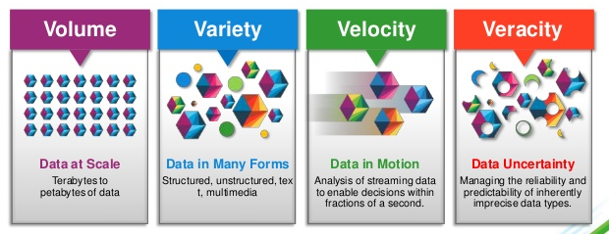
The four V’s of Big data
“Big data are high volume, high velocity, and high variety information assets that require new forms of processing to enable enhanced decision making, insight discovery and process optimization” (Gartner 2012)
Clicks, Logs, Events,
Social media, Transactions
Structured
Semi-Structured
Unstructured
Speed of generation
Real time analysis
Uncleaned
Untrusted
Notes:
http://www.ey.com/gl/en/services/advisory/ey-big-data-big-opportunities-big-challenges

Slide 6
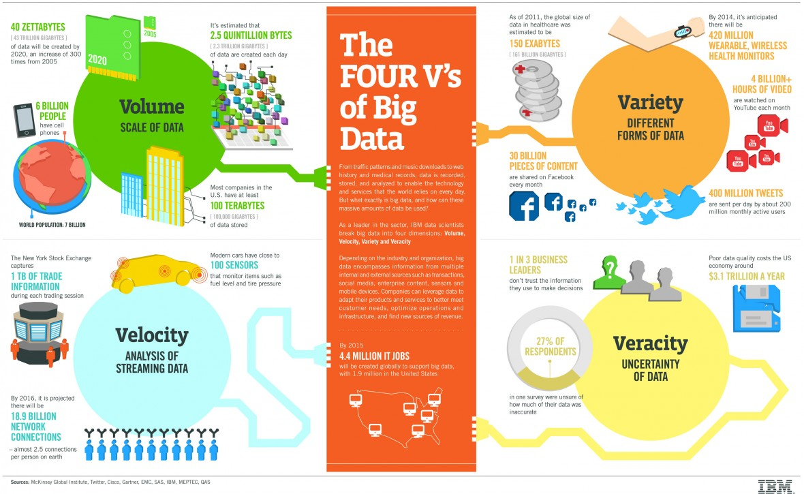
The four V’s of Big data

Slide 7
What is Big Data?
Volume
- exceeds limits of traditional column and row relational DB
- constantly growing
Vertical scalability
- ability to grow storage to accommodate new ‘records’
Requires
Velocity
- arrives rapidly, often in real time
Data streaming
real time processing, analysis and transformation
Requires
Variety
- does not have a standard structure, e.g. text, images
Horizontal scalability
- ability to add additional data structures
Requires
Notes:
Examples of data streaming = customised advertising on facebook / google

Slide 8










How is big data generated?
Sensors gathering information: e.g. Climate, traffic etc.
Social media: posts, pictures and videos
Digital satellite images
Purchase transaction records
Mobile phone GPS signals
High volume administrative
& transactional records

Slide 9
Data vs. Big Data
Professionals need to know how to conduct data analytics regardless of whether it is “Big”.
Transactional Data can tell us what has happened
Big Data and data analytics can often help explain why.
We need to embrace both.

Slide 10
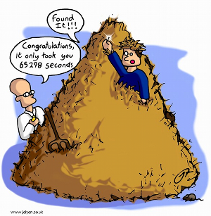
#2

Slide 11
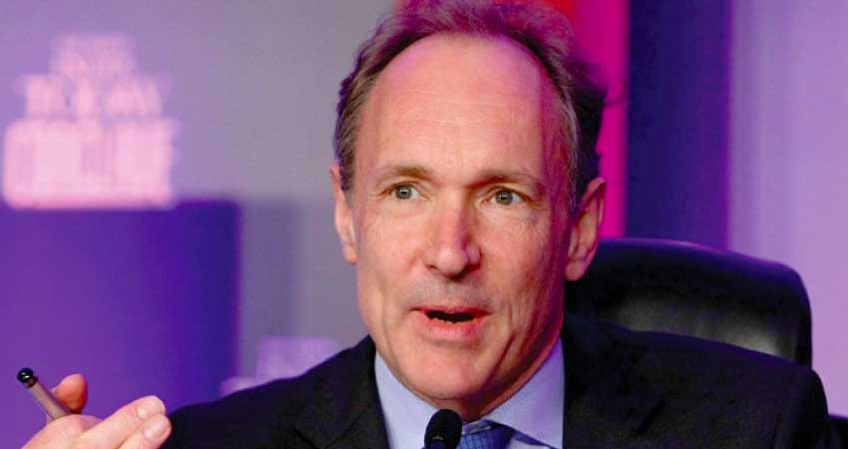
The new Internet - Linked data
להפוך את הסרטון למספר שקפי הסבר
What is linked data ?
12:20 >> 8:00

Slide 12
The Web Today
Universal resource identifiers (URIs) to identify documents.
The Hypertext Transfer Protocol (HTTP) to exchange documents between a client and a server.
HTML for marking up information to be presented to human readers through a browser.
Search Engines (Google!) to discover information.

Slide 13
Let’s organize a trip to Budapest using the Web!

Slide 14
You try to find a proper flight with …

Slide 15
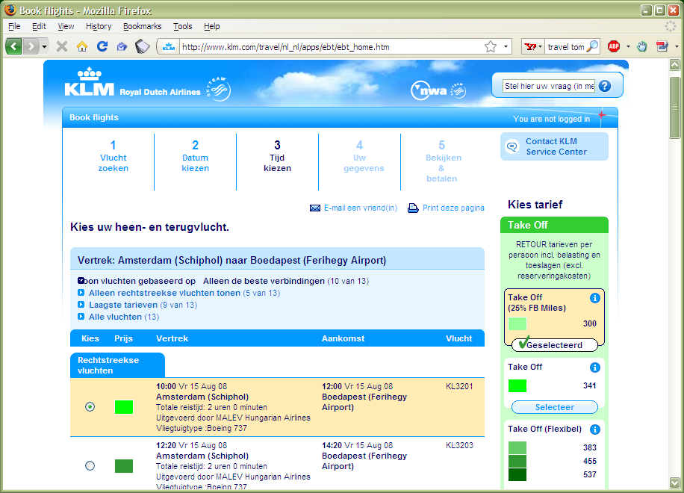
… a big, reputable airline, or …

Slide 16
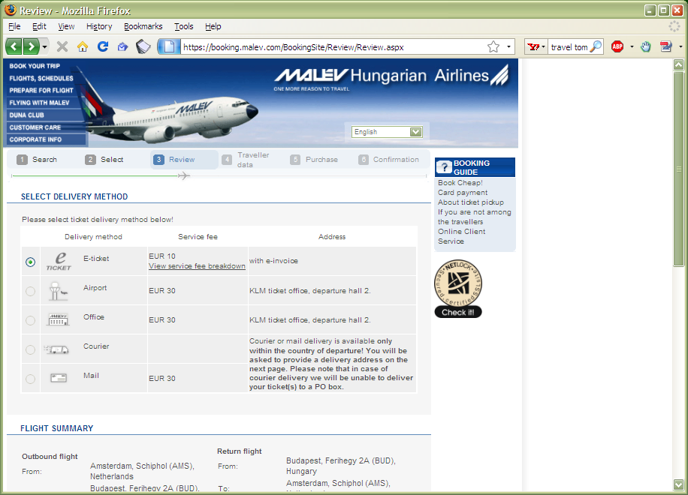
… the airline of the target country, or …

Slide 17
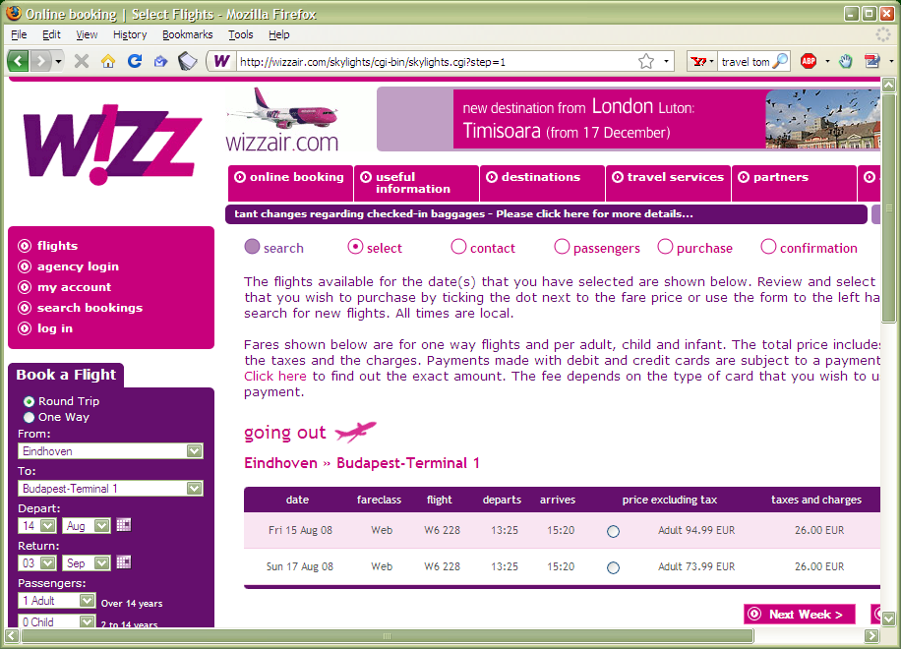
… or a low cost one

Slide 18
You have to find a hotel, so you look for…

Slide 19
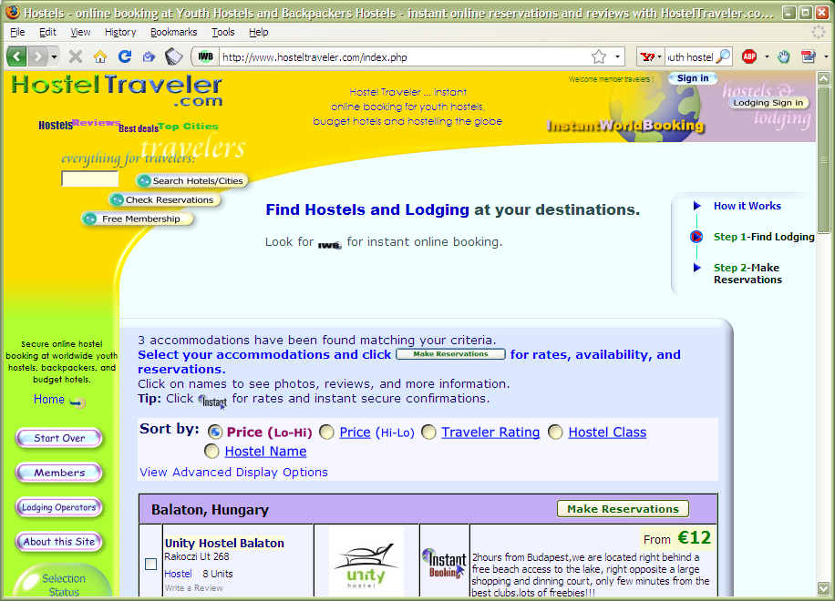
… a really cheap accommodation, or …

Slide 20
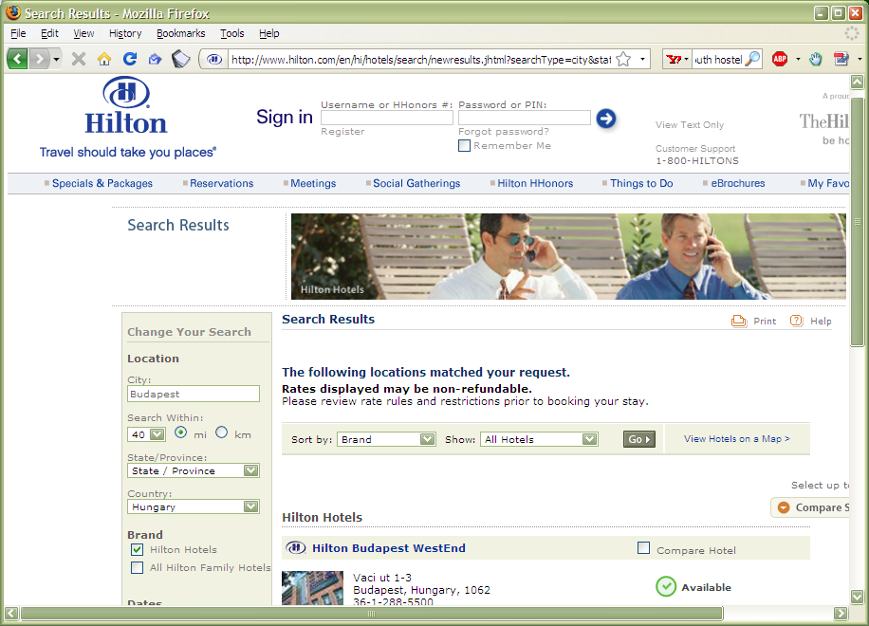
… or a really luxurious one, or …

Slide 21
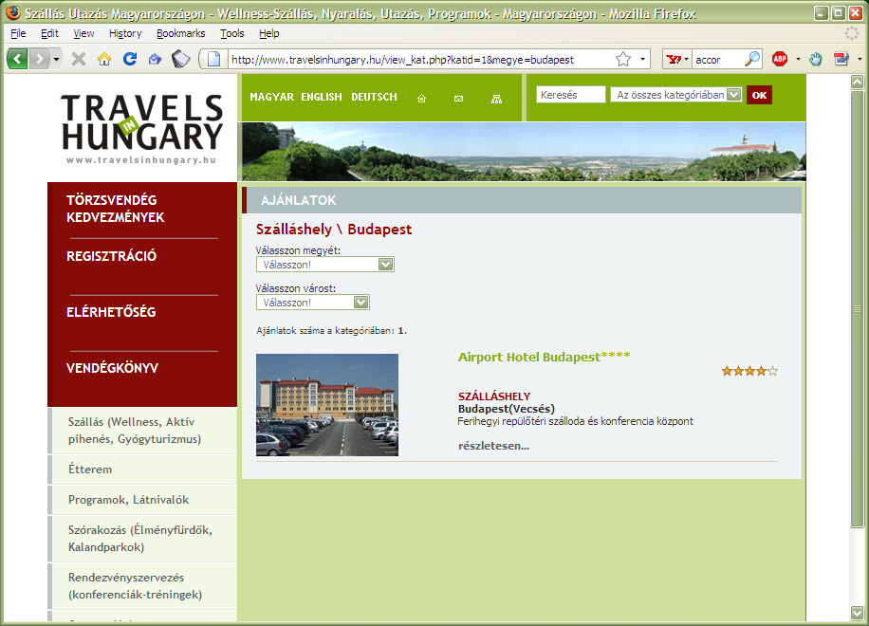
… an intermediate one …

Slide 22
oops, that is no good, the page is in Hungarian that almost nobody understands, but…
* Will occure also in Expedia

Slide 23
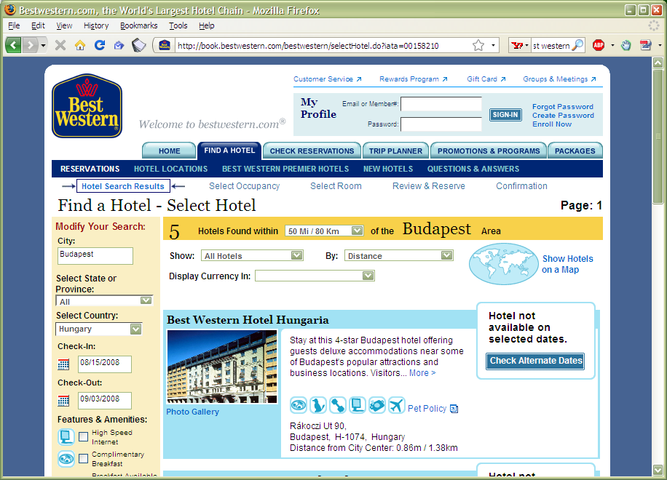
… this one could work

Slide 24
Of course, you could decide to trust a specialized site…

Slide 25
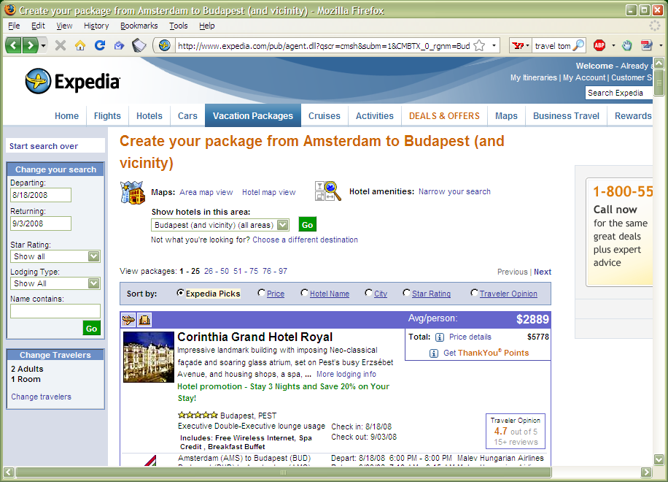
… like this one, or…

Slide 26
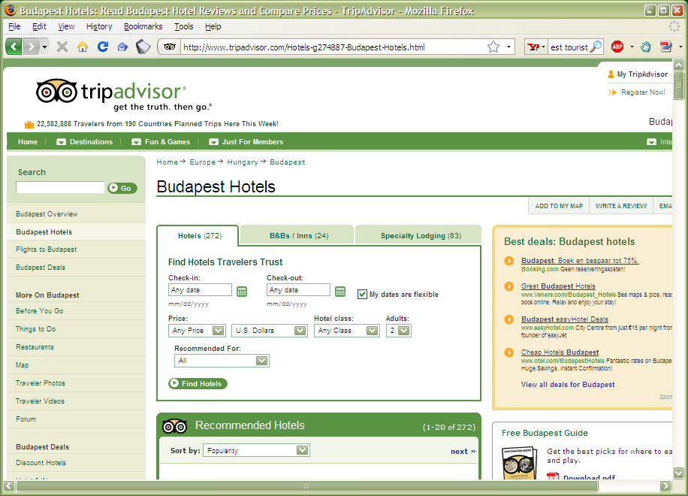
… or this one

Slide 27
You may want to know something about Budapest; look for some photographs…

Slide 28
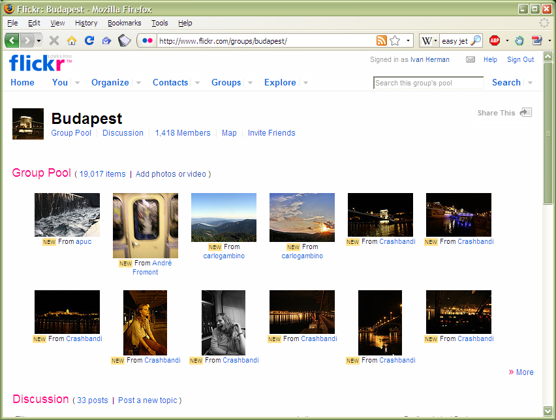
… on flickr …

Slide 29
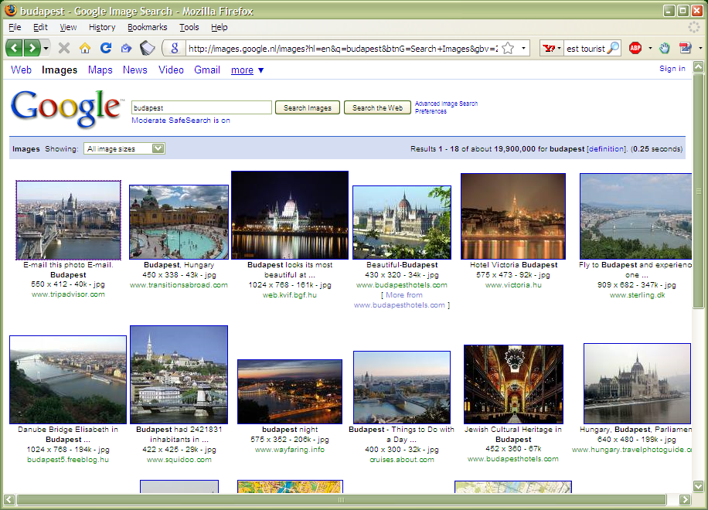
… on Google …

Slide 30
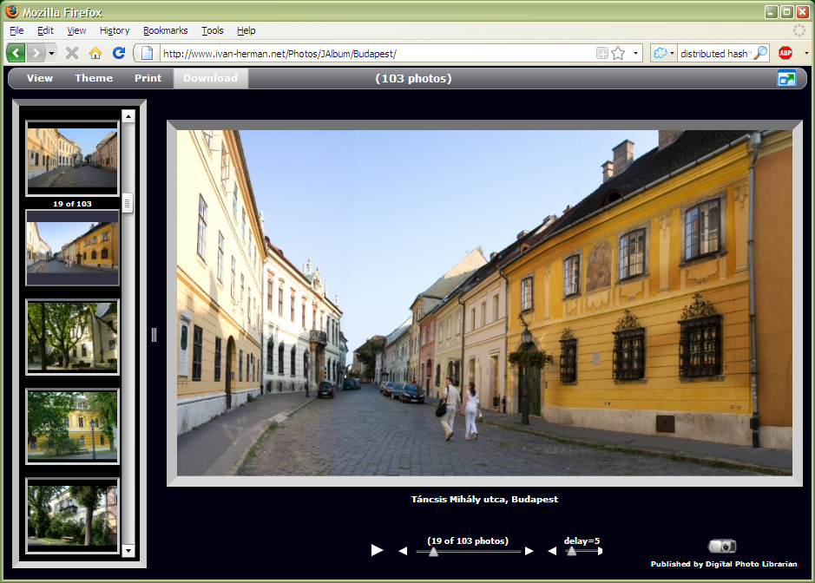
… or you can look at mine

Slide 31
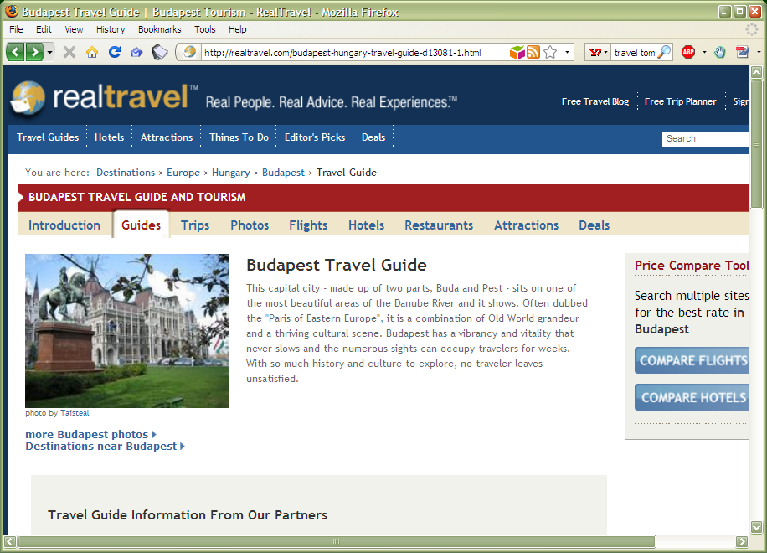
… or a (social) travel site

Slide 32
Amazing mind reader reveals his 'gift'….

Slide 33
What happened here?
You had to consult a large number of diverse sites, all different in style, purpose, possibly language…
You had to mentally integrate all those information to achieve your goals
We all know that, sometimes, this is a long and tedious process!
All those pages are only tips of respective icebergs:
the real data is hidden somewhere in databases, XML files, Excel sheets, …
you have limited access only to what the Web page designers allow you to see

Slide 34
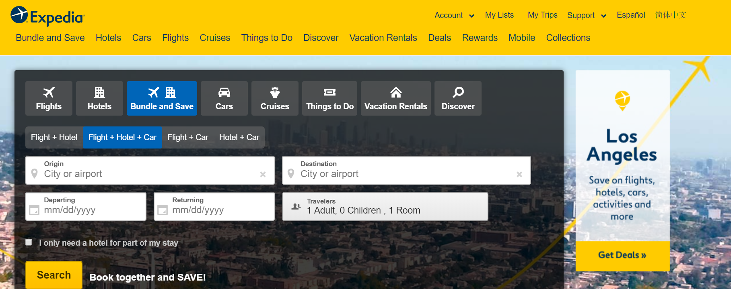
Specialized sites (Expedia, TripAdvisor) do a bit more:
they gather and combine data from other sources, But…
usually with the approval of the data owners)
they still control how you see those sources
But sometimes you want to personalize: access the original data and combine it yourself!

Slide 35
Using Search Engines – Example I
Assume that you want to learn about HTTP. What can you do?
Google it!

Slide 36
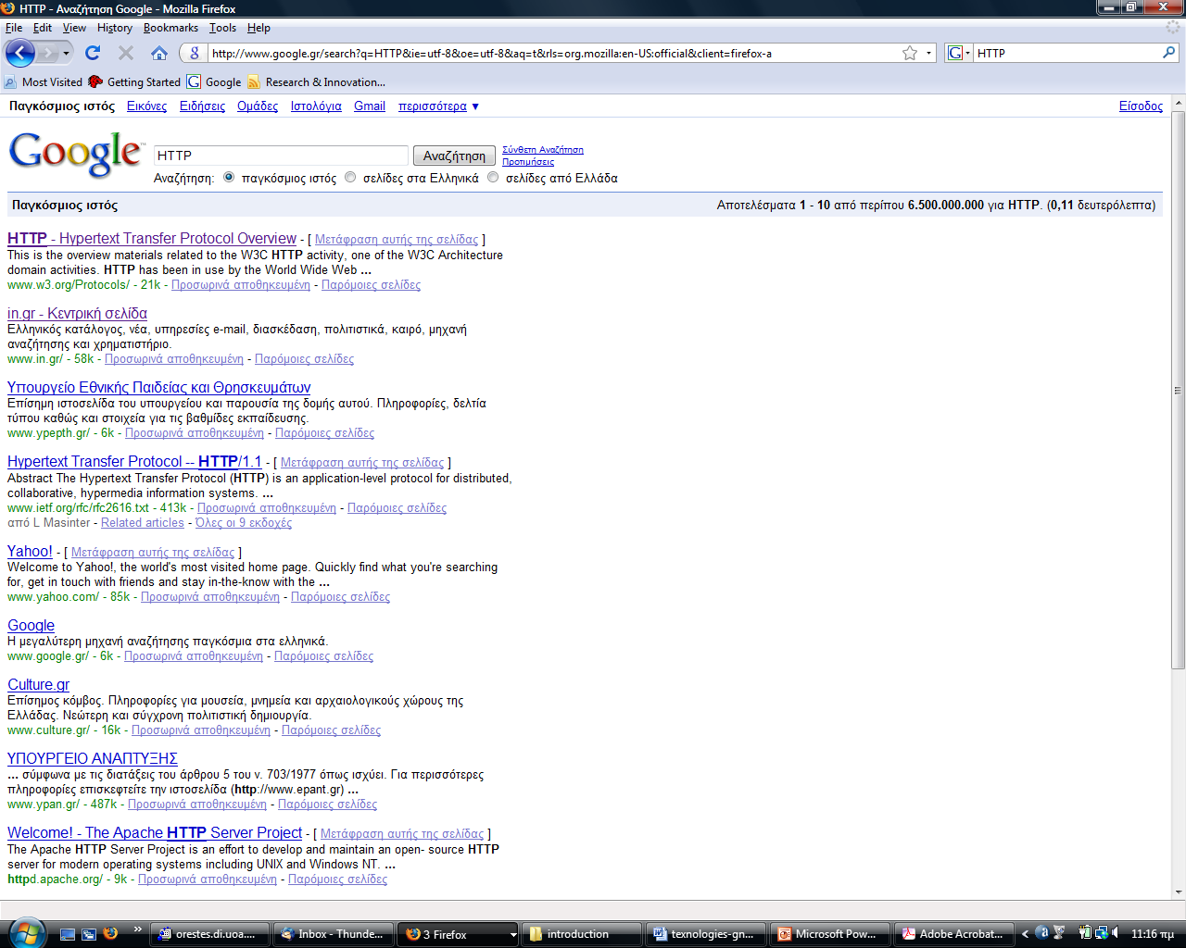
Example I (cont’d)

Slide 37
Example I (cont’d)
So search engines work very well, but are sensitive to vocabulary and have problems associated to precision and recall (e.g., high recall – low precision or low/no recall).

Slide 38
Search Engines – Example II
Assume that you want to buy the book “Semantic Web Primer”.
Google it!

Slide 39
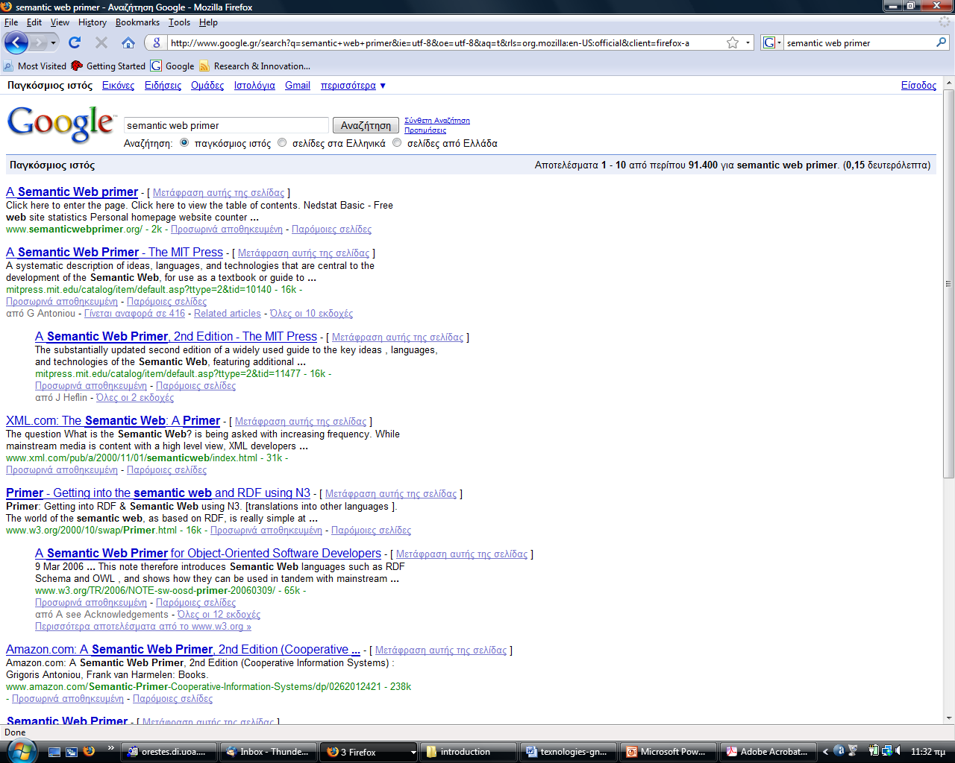
Example II (cont’d)

Slide 40
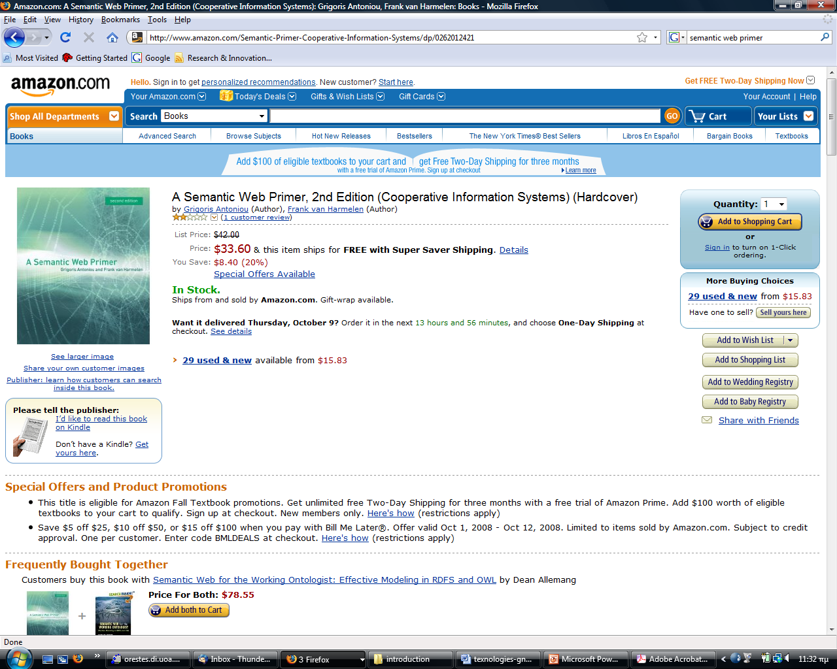
Example II (cont’d)

Slide 41
Search Engines – Example III
Assume now that you want to buy:
The cheapest copy of the book “Semantic Web Primer” or
The copy that will reach you earlier.
You can still use Google and your browser. But how many clicks do you need?
How about using some sort of shopbot e.g., http://www.kelkoo.co.uk/ ?

Slide 42
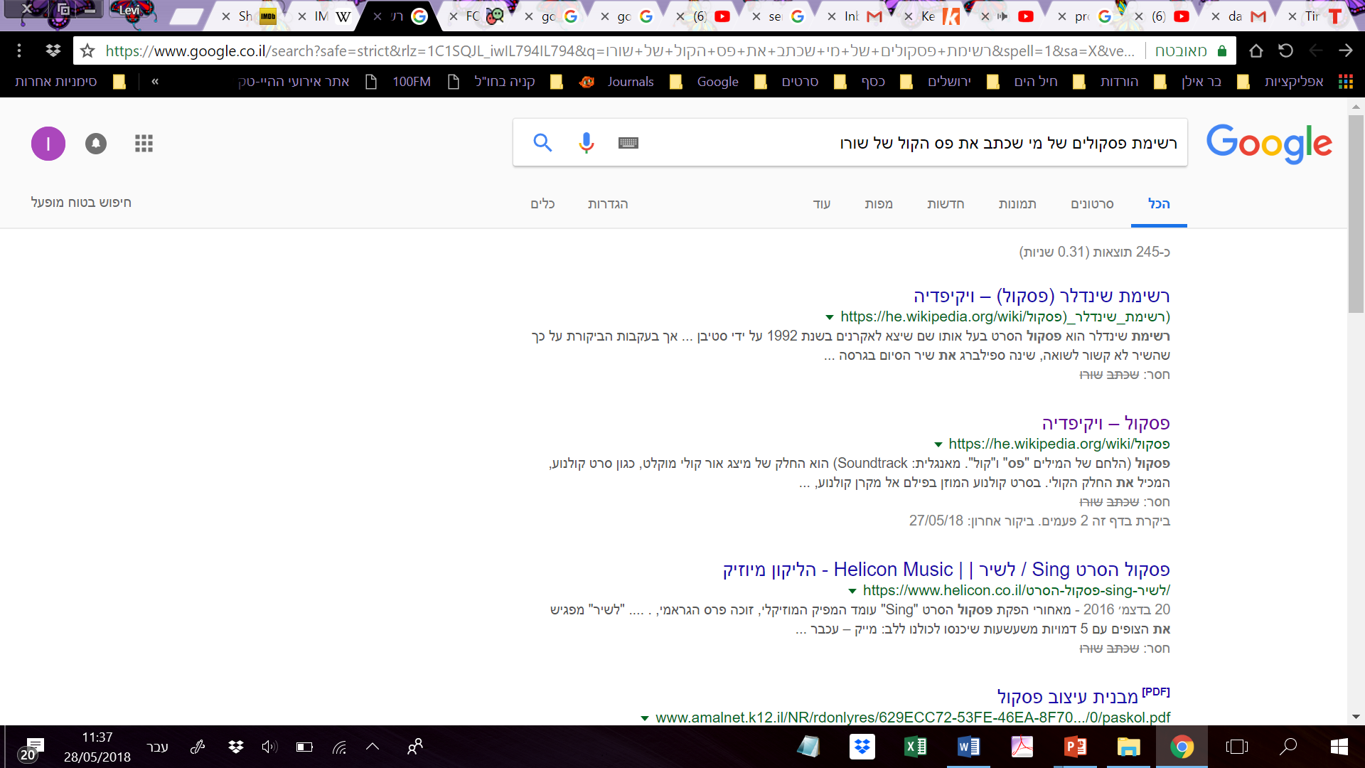
Search Engines – Example IV

Slide 43
Towards a Better Web!
“The Semantic Web will bring structure to the meaningful content of Web pages, creating an environment where agents roaming from page to page readily carry out sophisticated tasks for users.”
Notice the words meaning (semantics) and agents (a role for all of Artificial Intelligence).
Notes:
You can find the article on various Web sites e.g., http://www.dcc.uchile.cl/~cgutierr/cursos/IC/semantic-web.pdf

Slide 44
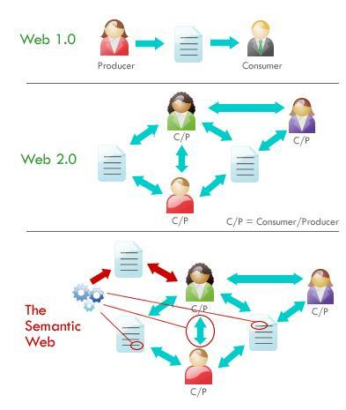
Semantic Web 3.0
E-mail
Linked Documents
Linked Data

Slide 45
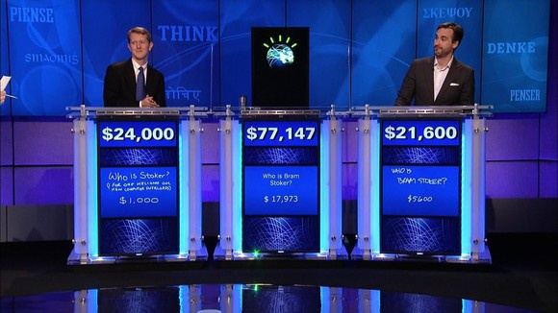

Slide 46
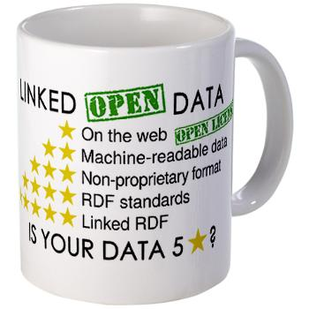
The new Internet - Linked data
What is linked data ?

Slide 47
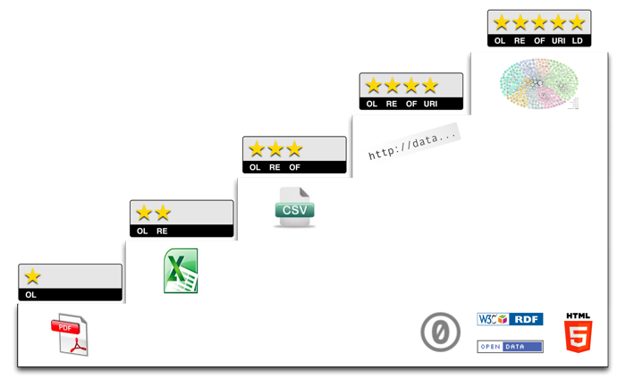
5-star Linked Open Data

Slide 48
How Can we Achieve the Semantic Web? – The Original Vision
Instead of publishing information to be consumed by humans, publish machine-processable data and metadata using terms/languages that can be understood by machines.
Build machines (agents) that will search for, query, integrate etc. this data.
Make sure all agents understand your terms/languages.

Slide 49

RDF Basics (Resource Description Framework)
The world consists of resources.
Resources are identified by URIs and described by simple properties and property values.
Example: “Angelina Jolie stars in the film Changeling directed by Clint Eastwood.”

Slide 50
RDF Statements
RDF statements are triples of the form
Subject , predicate , object
Example:
<http://dbpedia.org/page/Changeling_(film)> object
<http://dbpedia.org/ontology/starring> predicate
<http://dbpedia.org/page/Angelina_Jolie> subject
<http://dbpedia.org/page/Changeling_(film)> object
< http://dbpedia.org/ontology/director> predicate
<http://dbpedia.org/page/Clint_Eastwood> subject

Slide 51
RDF Graphs
object
dbpedia:Changeling_(Film)
predicate
predicate
dbpedia-owl:starring
dbpedia-owl:director
subject
subject
dbpedia:Angelina_Jolie
dbpedia:Clint_Eastwood

Slide 52
Example – Class Hierarchy
owl:Thing
rdfs:subClassOf
dbpedia-owl:Person
rdfs:subClassOf
rdfs:subClassOf
dbpedia-owl:Actor
dbpedia-owl:Film_Director
rdf:type
rdf:type
rdf:type
dbpedia:Angelina_Jolie
dbpedia:Clint_Eastwood

Slide 53
Example – Property Hierarchy
dbpedia-owl:spouseOf
rdf:subPropertyOf
rdf:subPropertyOf
dbpedia-owl:husbandOf
dbpedia-owl:wifeOf

Slide 54
Standard Vocabularies
Linked data are written using standard vocabularies i.e., vocabularies that have been agreed by certain communities for describing certain kinds of resources.
Examples:
FOAF
Dublin Core
schema.org

Slide 55

FOAF
The Friend of a Friend (FOAF) project has created a standard vocabulary for describing people, the links between them and the things they create and do.
See http://xmlns.com/foaf/spec/ for more information.

Slide 56
In what follows…
We will use a simplistic example to introduce the main technical concepts

Slide 57
The rough structure of data integration
Map the various data onto an abstract data representation
make the data independent of its internal representation…
Merge the resulting representations
Start making queries on the whole!
queries that could not have been done on the individual data sets

Slide 58
A simplified bookstore data (dataset “A”)

Slide 59
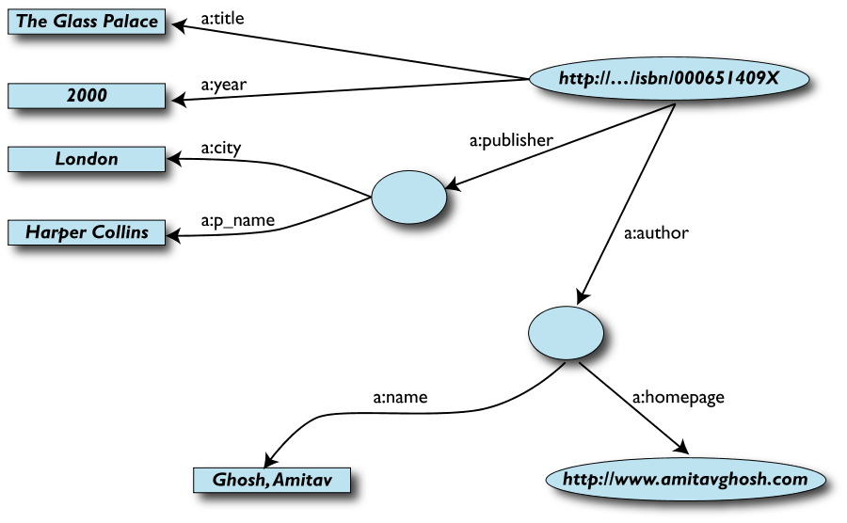
1st: export your data as a set of relations

Slide 60
Some notes on the exporting the data
Relations form a graph
the nodes refer to the “real” data or contain some literal
how the graph is represented in machine is immaterial for now
Data export does not necessarily mean physical conversion of the data
relations can be generated on-the-fly at query time
via SQL “bridges”
scraping HTML pages
extracting data from Excel sheets
etc.
One can export part of the data

Slide 61
Another bookstore data (dataset “F”)

Slide 62
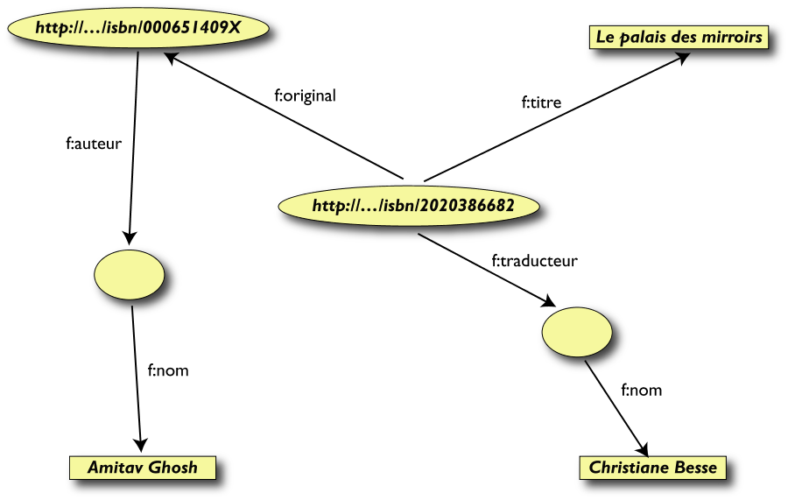
2nd: export your second set of data

Slide 63
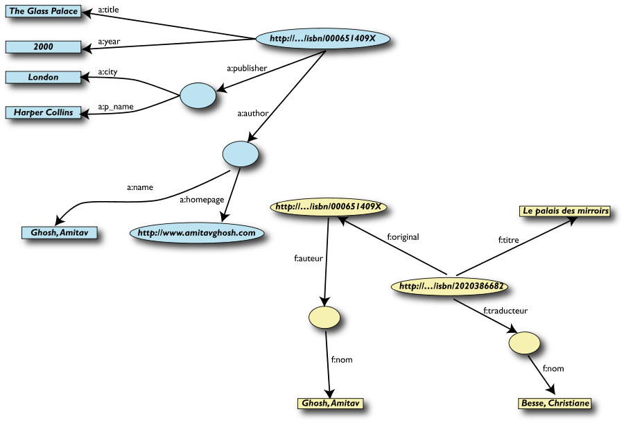
3rd: start merging your data

Slide 64
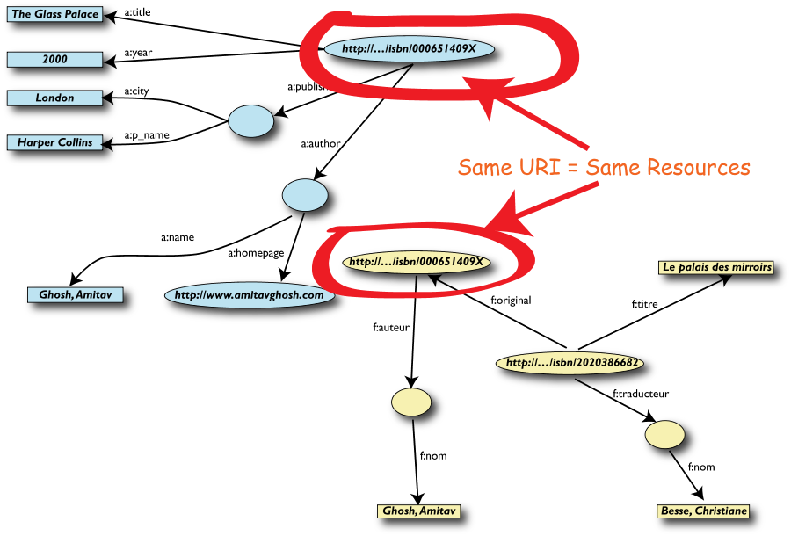
3rd: start merging your data (cont.)

Slide 65
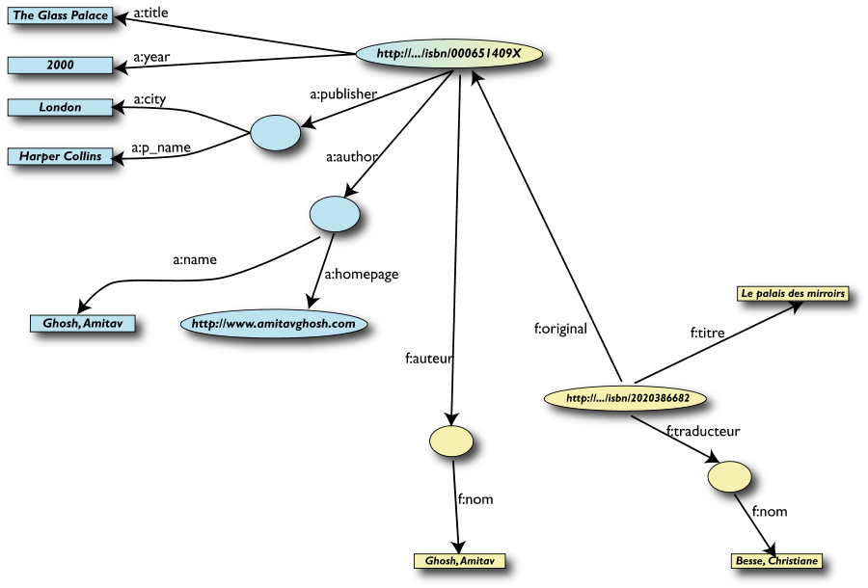
3rd: merge identical resources

Slide 66
Start making queries…
User of data “F” can now ask queries like:
“give me the title of the original”
well, … « donnes-moi le titre de l’original »
This information is not in the dataset “F”…
…but can be retrieved by merging with dataset “A”!

Slide 67
However, more can be achieved…
We “feel” that a:author and f:auteur should be the same
But an automatic merge doest not know that!
Let us add some extra information to the merged data:
a:author same as f:auteur
both identify a “Person”
a term that a community may have already defined:
a “Person” is uniquely identified by his/her name and, say, homepage
it can be used as a “category” for certain type of resources

Slide 68
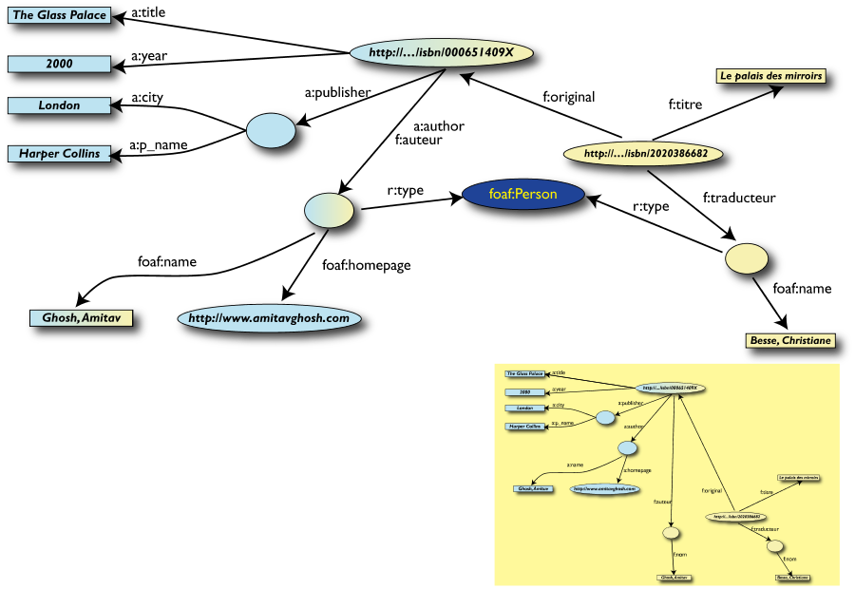
3rd revisited: use the extra knowledge

Slide 69
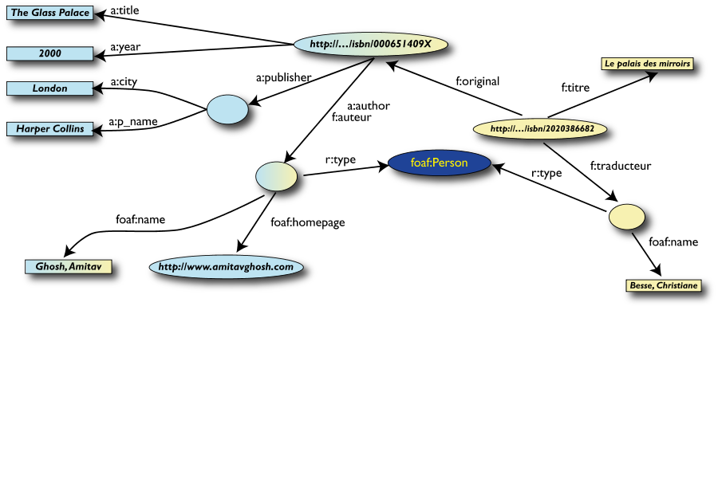
Start making richer queries!
User of dataset “F” can now query:
“donnes-moi la page d’accueil de l’auteur de l’originale”
well… “give me the home page of the original’s ‘auteur’”
The information is not in datasets “F” or “A”…
…but was made available by:
merging datasets “A” and datasets “F”
adding three simple extra statements as an extra “glue”

Slide 70
Combine with different datasets
Using, e.g., the “Person”, the dataset can be combined with other sources
For example, data in Wikipedia can be extracted using dedicated tools
e.g., the “dbpedia” project can extract the “infobox” information from Wikipedia already…

Slide 71
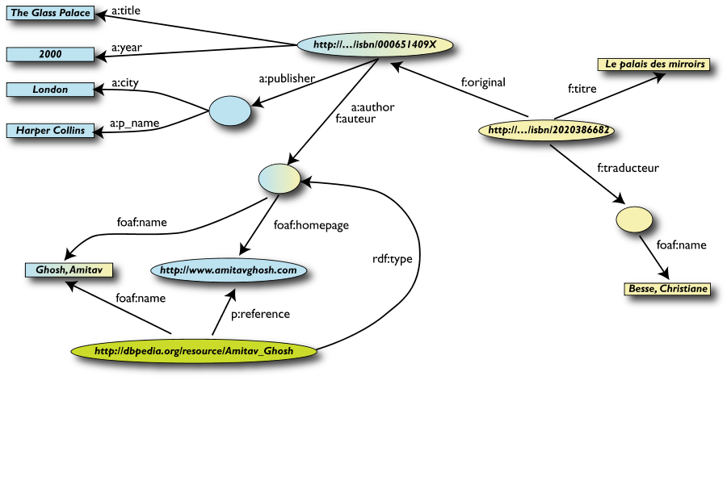
Merge with Wikipedia data

Slide 72
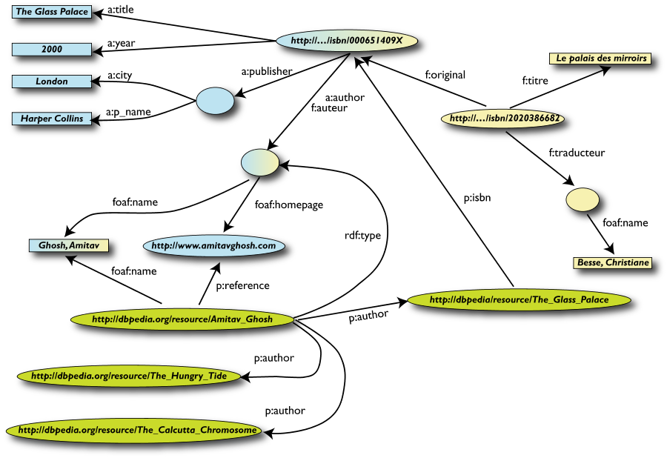
Merge with Wikipedia data

Slide 73
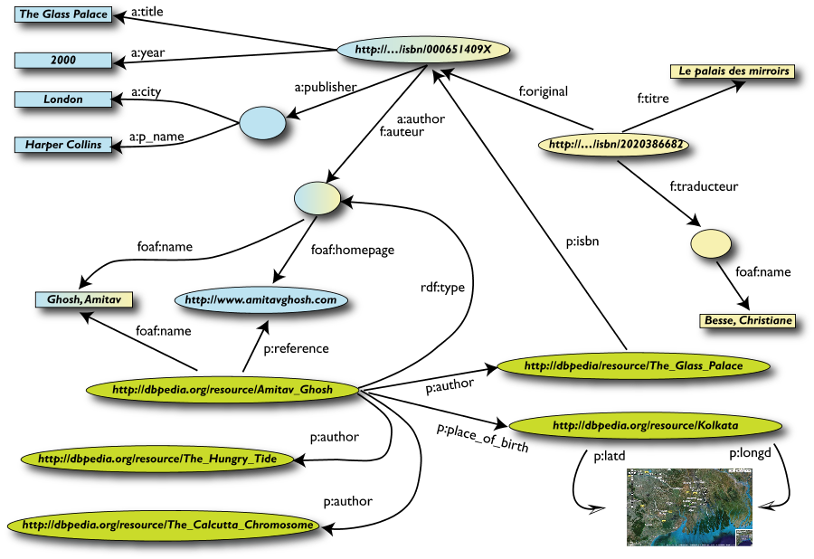
Merge with Wikipedia data

Slide 74
Is that surprising?
It may look like it but, in fact, it should not be…
What happened via automatic means is done every day by Web users!
The difference: a bit of extra rigour so that machines could do this, too

Slide 75
What did we do?
We combined different datasets (A, F) that
are somewhere on the web
are of different formats (mysql, excel sheet, XHTML, etc)
have different names for relations
We could combine the data because some URI-s were identical (the ISBN-s in this case)
We could add some simple additional information (the “glue”), possibly using common terminologies that a community has produced
As a result, new relations could be found and retrieved
More powerful queries can be asked as a result

Slide 76
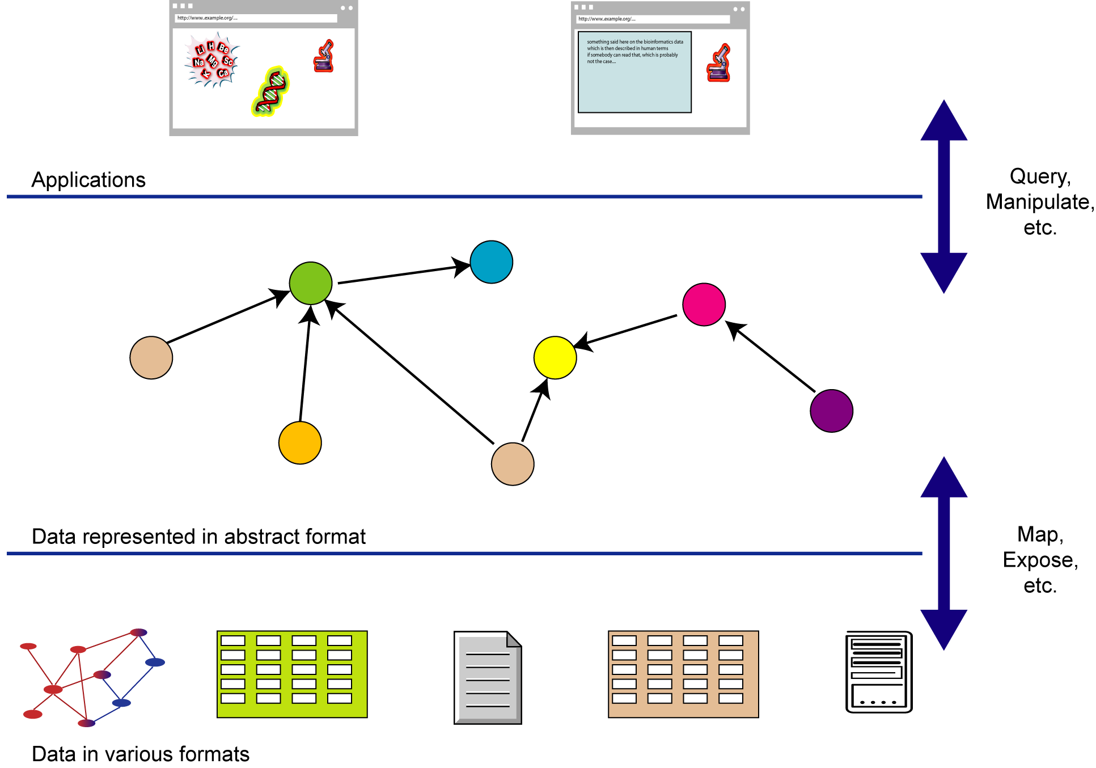
What did we do? (cont)

Slide 77
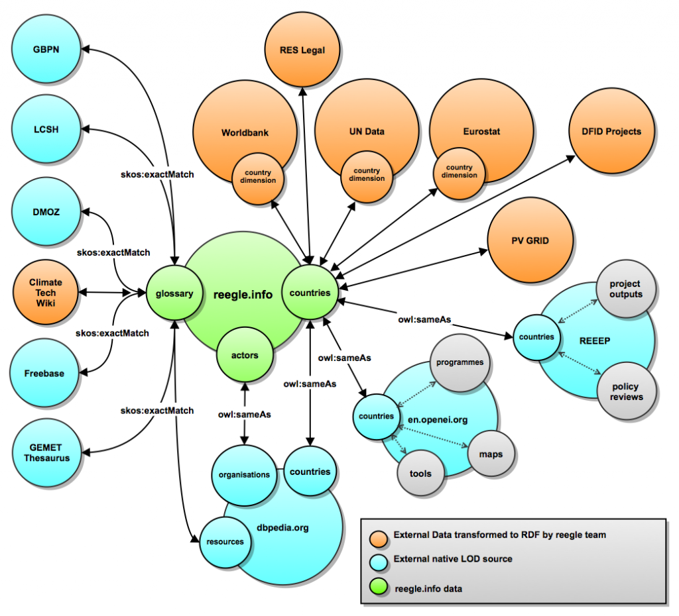

Slide 78
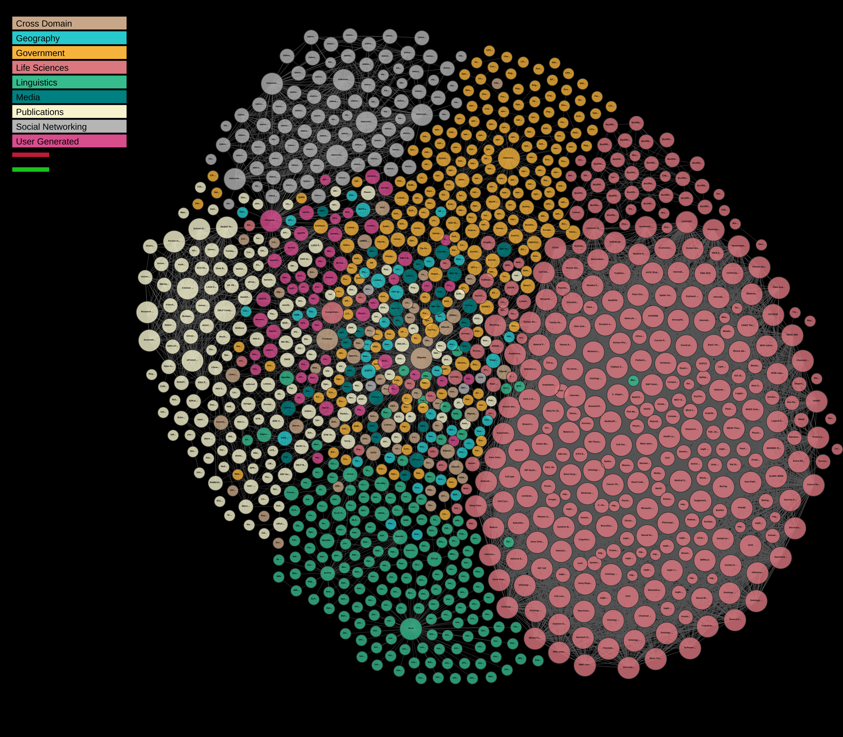

Slide 79
SPARQL
SPARQL stands for “SPARQL Protocol and RDF Query Language”.
It is the standard query language for RDF data proposed by the W3C.
It is based on matching graph patterns against RDF graphs.
The simplest kind of graph pattern is a triple pattern.
A triple pattern is like an RDF triple, but with the option of a variable in the subject, predicate or object positions.

Slide 80
Example Dataset
@prefix rdf: <http://www.w3.org/1999/02/22-rdf-syntax-ns#> .
@prefix foaf: <http://xmlns.com/foaf/0.1/> .
@prefix rdfs: <http://www.w3.org/2000/01/rdf-schema#> .
<http://en.wikipedia.org/wiki/Angelina_Jolie#this>
rdf:type foaf:Person ;
foaf:name “Angelina Jolie" ;
foaf:mbox <mailto:ajolie@gmail.com> ;
foaf:homepage <http://www.AngelinaJolie.com/> ;
foaf:interest <http://en.wikipedia.org/wiki/UNHCR> ;
foaf:knows [ rdf:type foaf:Person ;
foaf:name “Michael Douglas" ] .

Slide 81
Example SPARQL Query
SELECT ?name
WHERE { ?x foaf:name ?name .
?x rdf:type foaf:Person .
?x foaf:knows ?y .
?y foaf:name “Michael Douglas” .
}
Result:
?name
“Angelina Jolie"

Slide 82
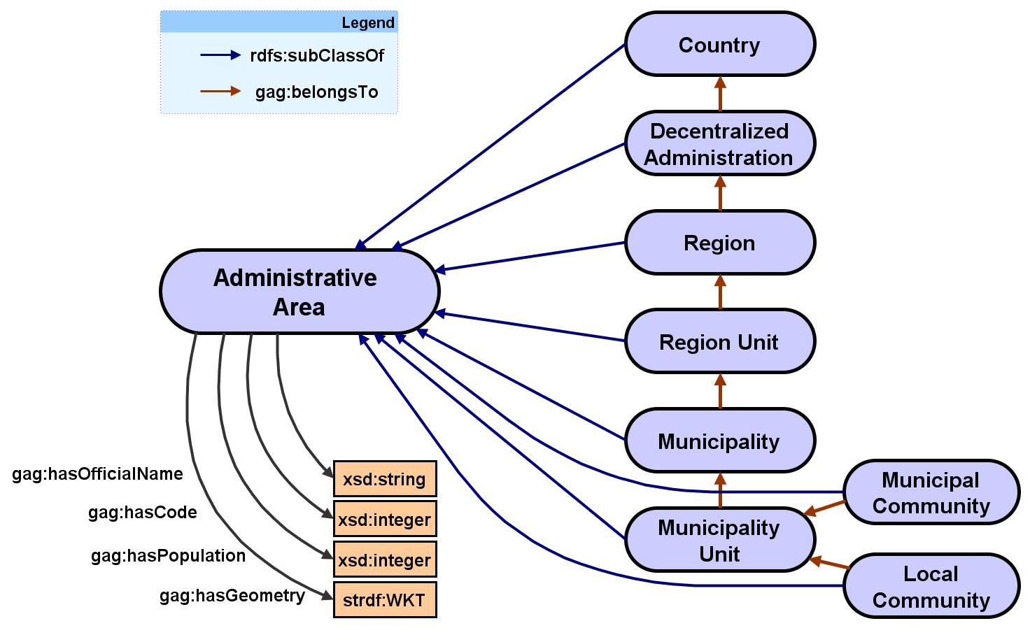
Example: the GAG RDFS Ontology
Today the word ontology is a synonym for a shared knowledge base.

Slide 83



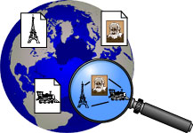

Example of Very Large Ontologies
Dbpedia
YAGO
Cyc Wordnet
Freebase
Knowledge Graph
TextRunner

Slide 84
From the DBpedia Web site (http://dbpedia.org/About):
DBpedia is a community effort to extract structured information from Wikipedia and to make this information available on the Web.
The DBpedia knowledge base currently describes more than 3.5 million things, out of which 1.67 million are classified in a consistent Ontology, including 364,000 persons, 462,000 places, 99,000 music albums, 54,000 films, 17,000 video games, 148,000 organisations, 169,000 species and 5,200 diseases.
The DBpedia knowledge base has several advantages over existing knowledge bases: it covers many domains; it represents real community agreement; it automatically evolves as Wikipedia changes, and it is truly multilingual.

Slide 85

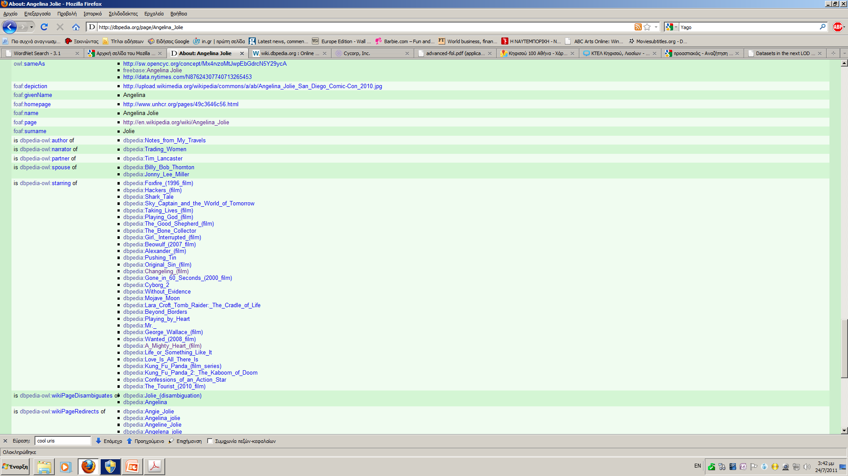
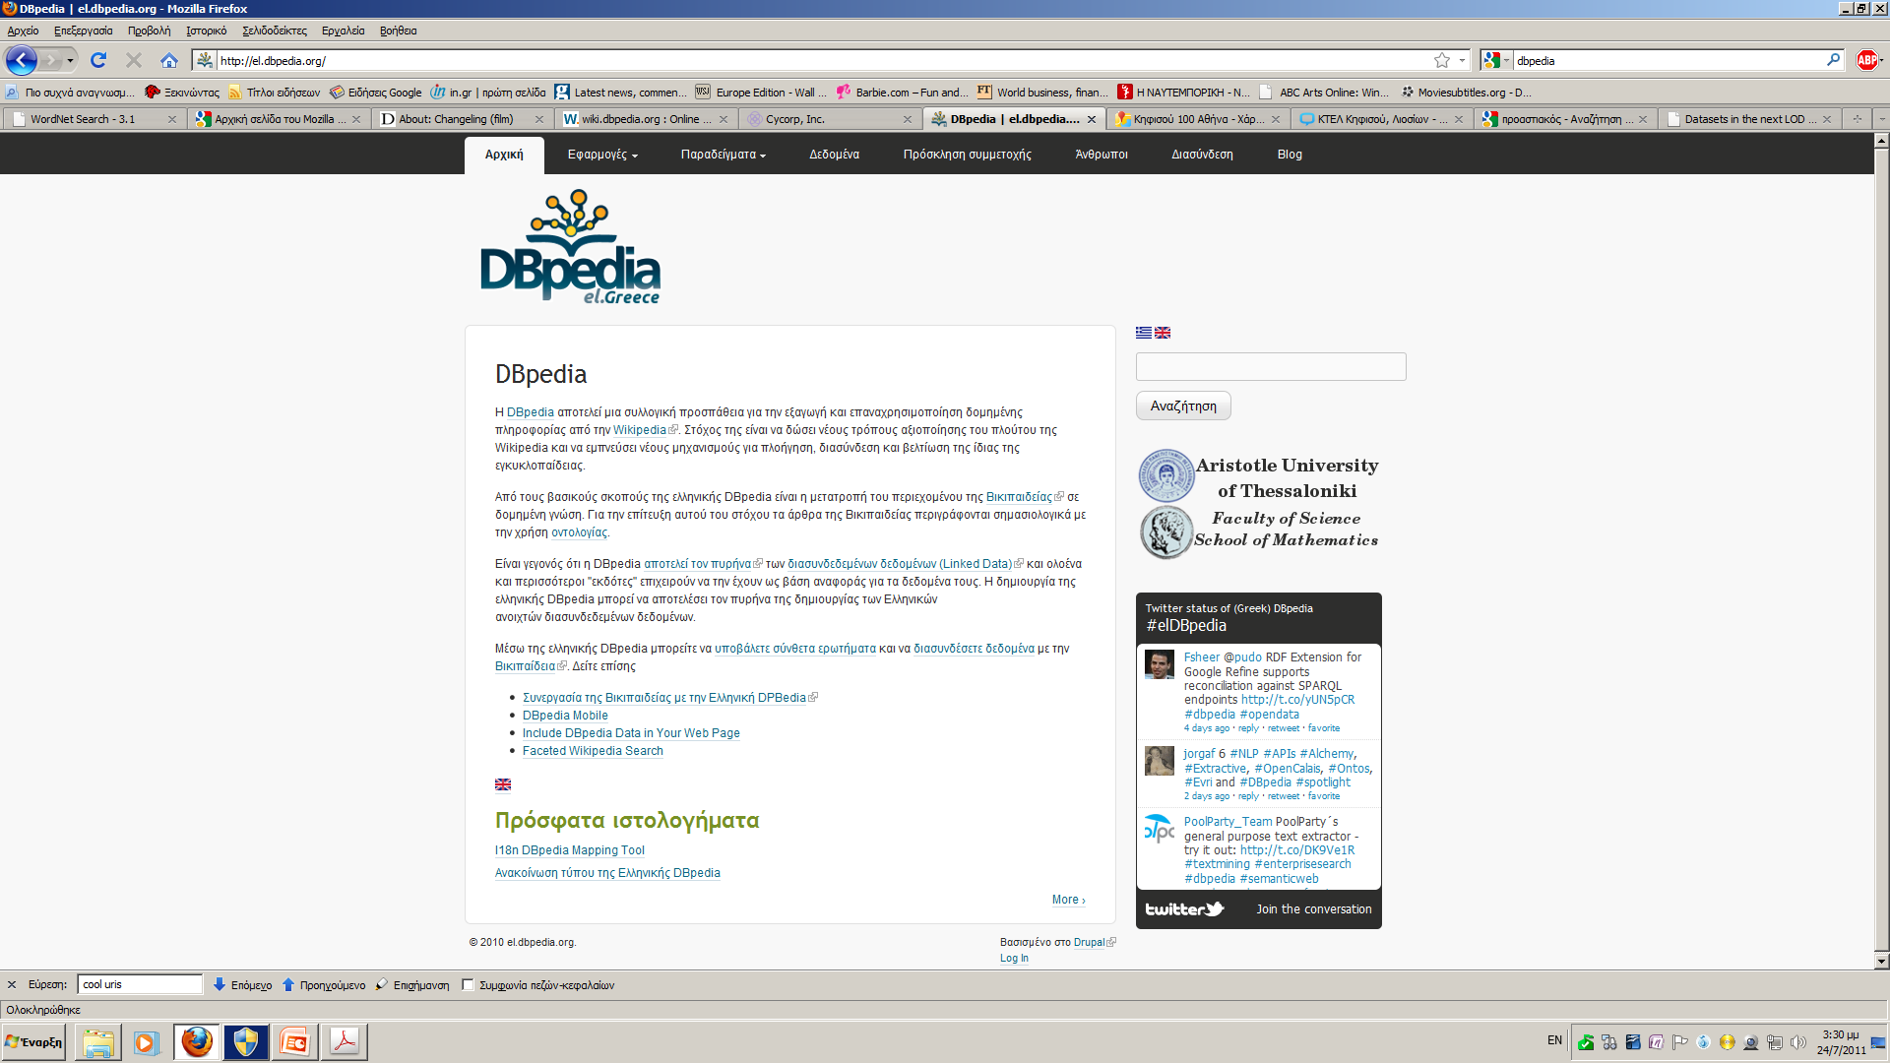
http://dbpedia.org/page/Angelina_Jolie

Slide 86
YAGO
From the YAGO Web page (http://www.mpi-inf.mpg.de/yago-naga/yago/):
YAGO2 is a huge semantic knowledge base, derived from Wikipedia, WordNet and GeoNames. Currently, YAGO2 has knowledge of more than 10 million entities (like persons, organizations, cities, etc.) and contains more than 80 million facts about these entities.
In YAGO2, we made an effort to treat time and location data as first-class citizens, extending the basic triple model by special fields for time and location for querying. Also, we took special care to consistently attach temporal and spatial data to all facts where it is semantically meaningful and where time and location can be derived from Wikipedia.

Slide 87
Very Large Ontologies
Recently there has been a lot of work on developing very large ontologies that capture various areas of human knowledge and deploying this knowledge in applications such as search engines or question answering.
Example: Watson, IBM’s question answering system that beat humans in the quiz show Jeopardy

Slide 88
Big Data Challenges for CI
Storing unprecedented volumes of data (and accelerating)
Data production passed storage capacity in 2007
Cost differential is increasing, Rate of data production is increasing
Describing what we have in ways that are helpful to future users (and our future selves)
Metadata and Semantics for describing content (this tends to be producer-focused)
But also use-case metadata and emergent relationships (tends to be consumer-focused)
Finding what we need, in the context of our current task
semantically-enabled search engines that can use the above descriptions, (ideally from within analytical tools and workflows)
Working out what we do not need to keep
Because it will not be used again or offers no ‘information gain’
Because it is easier to recreate than to store
Governing data collections well, within their communities of use
information and knowledge portals
effective governance of data resources
quality control strategies, including peer review and rewarding excellent contributions
Notes:
Secondary use outweighs primary use in some disciplines…

